Slide 1
PRESENTED BY :-
HEMRAJ GUPTA

Slide 2
PROJECT - 1
SIMPLE CALCULATOR USING PYTHON

Slide 3
PROJECT OVERVIEW -
A Calculator is basically a program on a computer that simulates the behavior of any hand – held calculator useful for performing mathematical calculations. It is a very basic device used in our everyday lives. Now all the smartphones also have a calculator application in them.
While creating any GUI Application there are mainly two steps :
The first step is to create a User interface.
The second step is the most important one and in this, to add functionalities to the GUI

Slide 4
Outlined below are the essential features deemed indispensable for this application:
An equation display area (screen) to exhibit the mathematical expressions and their respective results.
Clickable buttons, each representing numerical values or mathematical operations.
Core mathematical operations functionality, encompassing addition, subtraction, multiplication, and division.
Seamless execution of mathematical calculations, yielding results (=), coupled with the ability to clear the equation display (c).

Slide 5
Tools and Technologies
Tools - Python , Visual Studio
Python Libraries – tkinter,GUI etc.

Slide 6
Tkinter
Tkinter is the standard GUI library for Python. Python when combined with tkinter provides a fast and easy way to create GUI applications.
Tkinter provides a powerful object – oriented interface to the Tk GUI toolkit.

Slide 7
Visual Studio
Visual Studio is a powerful developer tool that you can use to complete the entire development cycle in one place. It is a comprehensive integrated development environment (IDE) that you can use to write, edit, debug, and build code, and then deploy your app. Beyond code editing and debugging, Visual Studio includes compilers, code completion tools, source control, extensions, and many more features to enhance every stage of the software development process.

Slide 8
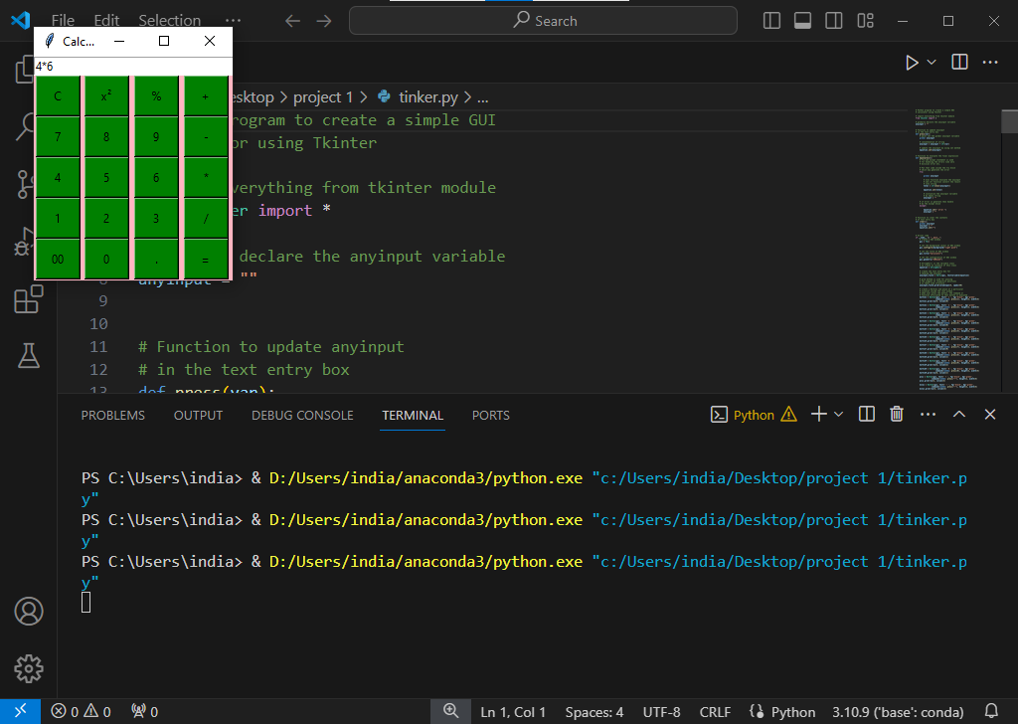
output

Slide 9
CONCLUSION:
AFTER COMPLITION MY PRODUCT I KNOW ABOUT THE -
1. Core Python
2. tkinter Library
3 Visual Studio Code[IDE]
4. GitHub
5. Git Bash
6. Application development using Python programming language

Slide 10
Thank you ..

Slide 11
ANY QUARY ?

